Slide 1

Predicting Malaria Incidence Using Global Health Data
Capstone Project - Introduction to Big Data Analytics (INSY 8413)
Name: Rugandura Maurice
ID: 27718
Instructor: Eric Maniraguha
Date: July 2025

Slide 2

The Challenge: Predicting Malaria Trends
Can we analyze and predict malaria trends over time using country-level data on incidence, mortality, and infection prevalence?
Repository: 🌍mauricerugandura/mon_wed_27718_Malaria-Incidence-Prediction-and-Analysis: This project explores and predicts malaria incidence rates using global health data.Using historical malaria metrics from national health units, we analyze trends and build a predictive model to estimate future incidence rates across various countries.
Dataset: 🌍 https://openafrica.net/dataset/global-malaria-national-unit-statistics/resource/b4b5034c-2663-4cea-b7ed-ff8ef447f817
Power Bi: https://github.com/mauricerugandura/mon_wed_27718_Malaria-Incidence-Prediction-and-Analysis/blob/1d5f31e02420124befe579e1fa264073a418d738/Power%20BI/Global%20Malaria%20Overview.pbix
🌍 https://github.com/mauricerugandura/mon_wed_27718_Malaria-Incidence-Prediction-and-Analysis/blob/1d5f31e02420124befe579e1fa264073a418d738/Power%20BI/Malaria%20Prediction%20Dashboard.pbix

Slide 3
Data Source
Sector
Key Metrics
Health
Incidence Rate
Source
Mortality Rate
Infection Prevalence
OpenAfrica
Country & Year
Dataset
Malaria National Unit Data
File Used
malaria_cleaned_with_coords.csv

Slide 4




Project Objectives
Analyze Trends
Build Predictive Model
Create Dashboard
Examine malaria incidence and mortality across countries.
Develop a model for future malaria incidence.
Design an interactive Power BI dashboard.

Slide 5




Methodology Overview
Step 1: Data Cleaning
Step 2: EDA
Utilizing Python for initial data preparation.
Exploratory Data Analysis to uncover insights.
Step 3: Machine Learning
Step 4: Power BI
Applying Linear Regression for predictions.
Dashboard development for visualization.

Slide 6
Data Cleaning Process
Removed Values
Standardized Codes
Missing & irrelevant data points.
Ensured consistent country codes.
Merged Datasets
Exported Clean File
Combined malaria data with coordinates.
malaria_cleaned_with_coords.csv for further use.

Slide 7
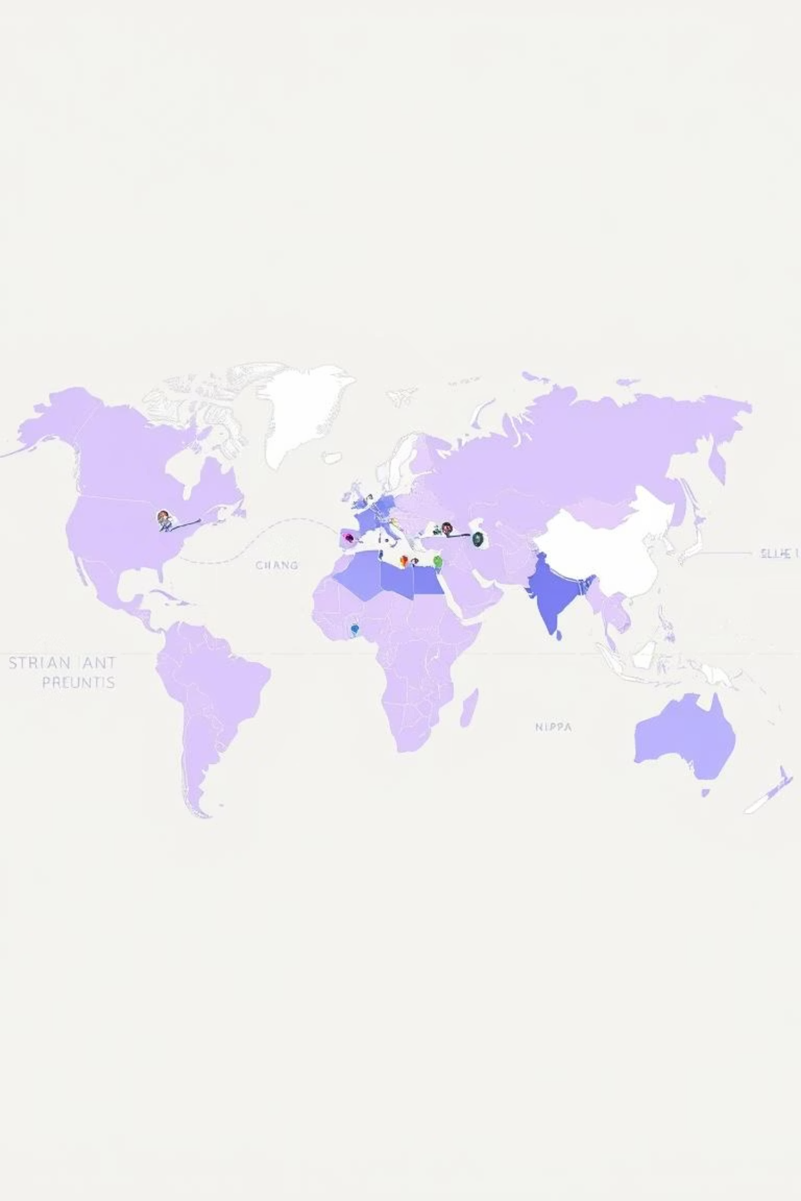
Exploratory Data Analysis (EDA)
Identified countries with highest/lowest malaria rates.
Plotted trend lines for multiple years.
Highlighted regional disparities.

Slide 8
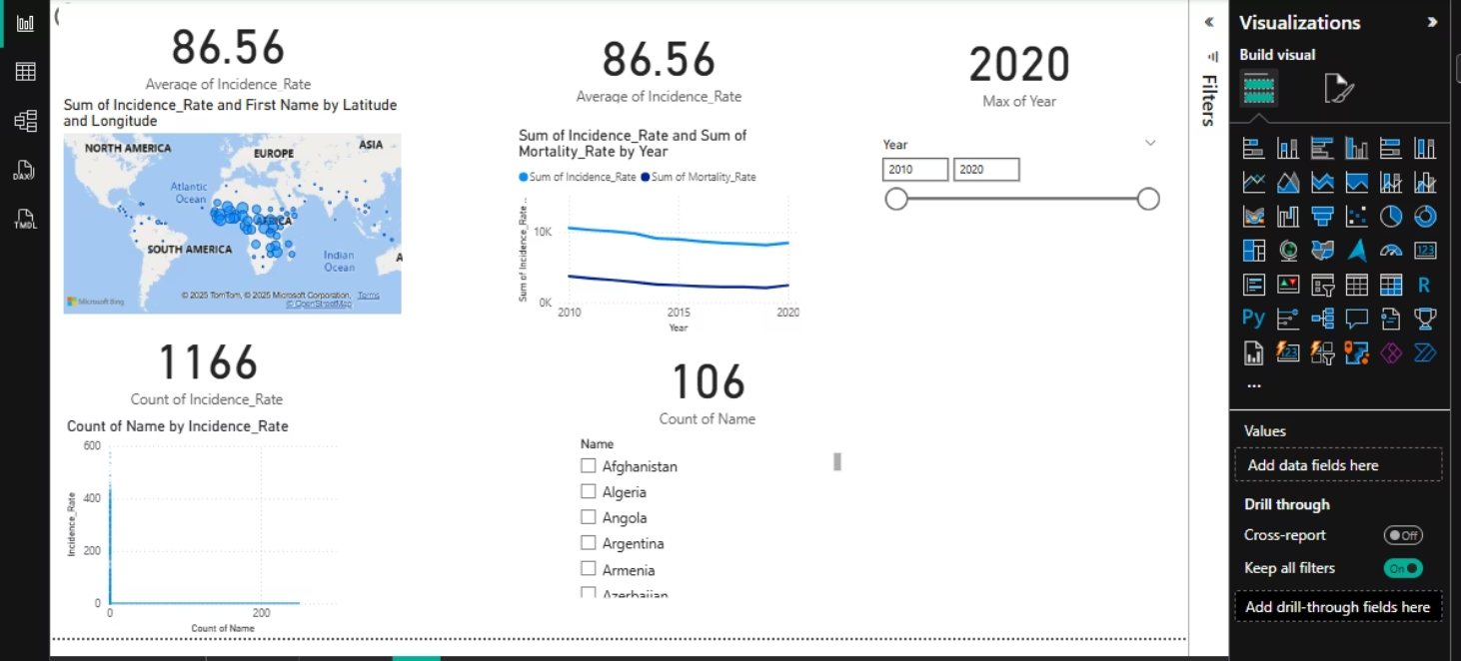
POWER BI
dashboard of EDA(Exploratory Data Analysis)

Slide 9

Machine Learning Model
Model Used
Evaluation
Linear Regression
Using MSE & R² score.
Training
Output
On historical incidence data.
malaria_predictions.csv

Slide 10
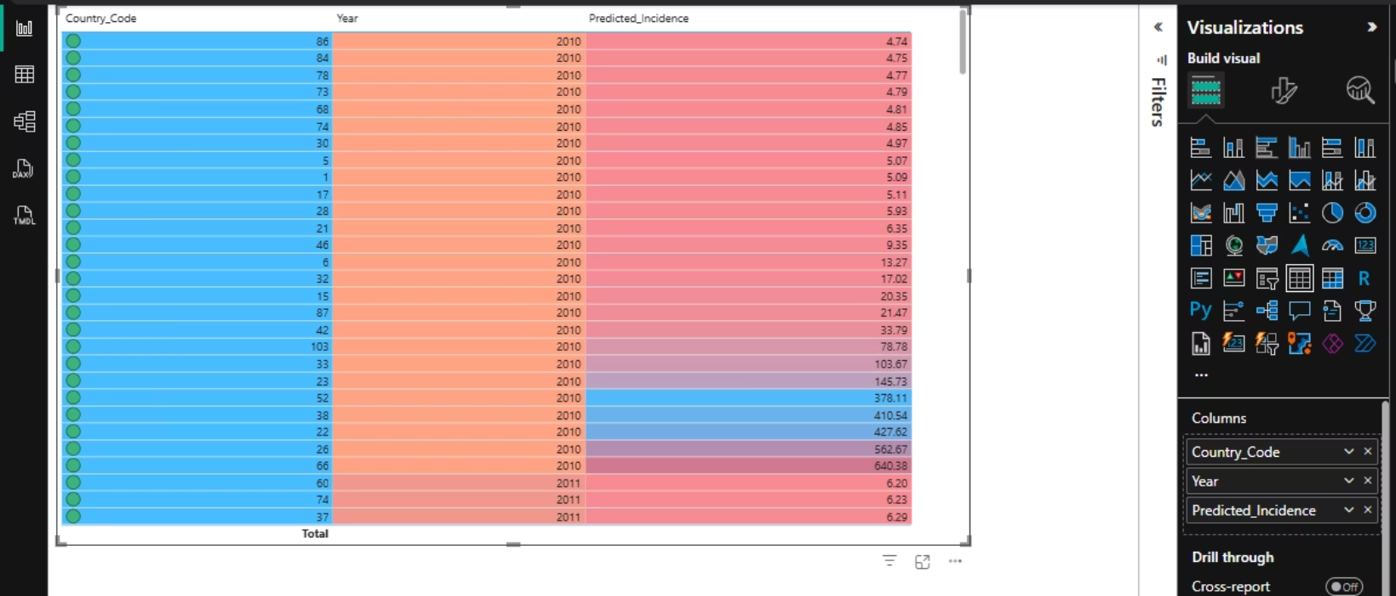
POWER BI
dashboard of ML(Machine Learning model)

Slide 11




Power BI Dashboard Features
Yearly Trends
Top Affected Countries
Chart displaying malaria trends over time.
Bar chart highlighting high-incidence nations.
Predicted Rates Map
Summary Cards
Geospatial visualization of predicted rates.
Key insights and data summaries.

Slide 12

Key Findings & Conclusion
Malaria incidence is decreasing in some regions.
High-risk countries remain consistently vulnerable.
Predictions help prioritize resources.
Demonstrated power of data analytics in public health.
Built a complete pipeline from raw data to visualization.
Project can guide future resource planning.

